Slide 1
TortoiseGit Setup and Basics
About the installation TortoiseGit and basic user functions of it
Murathan Durmuş

Slide 2
INDEX
Installation
Configuration the Git URL and Password
Repository Processes
Getting Status Informations
Pull & Fetch, Push
Synchronization
Daemon
Browse the References
Submodules
Revision Graphs
Adding, Moving and Deleting File/Folder
Undo Changes
Merging
Who Changed Which Line: Blame for Files
Git LFS (Large File Support) Locking
This presentation is prepared as a Basic User Guide for TortoiseGit. For detailed information, please visit: tortoisegit.org/docs/tortoisegit/tgit-dug.html

Slide 3
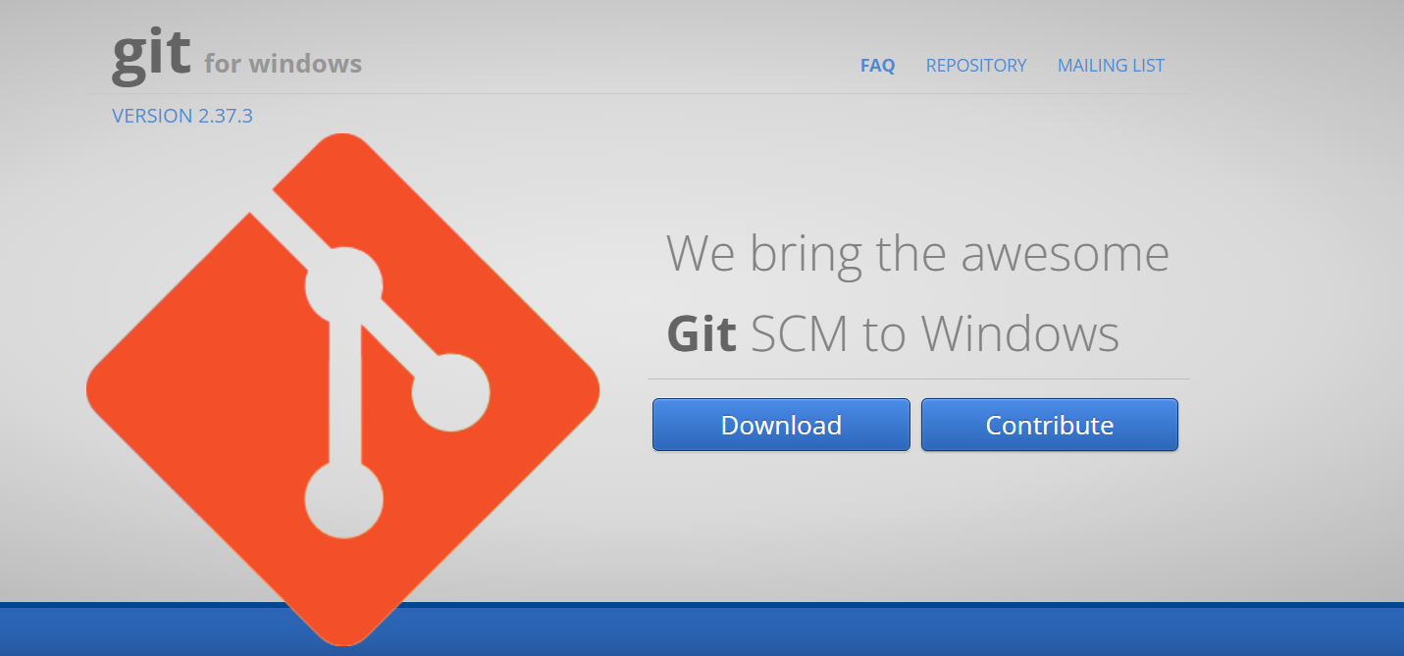
Installation of git for Windows
gitforwindows.org ->> Download

Slide 4
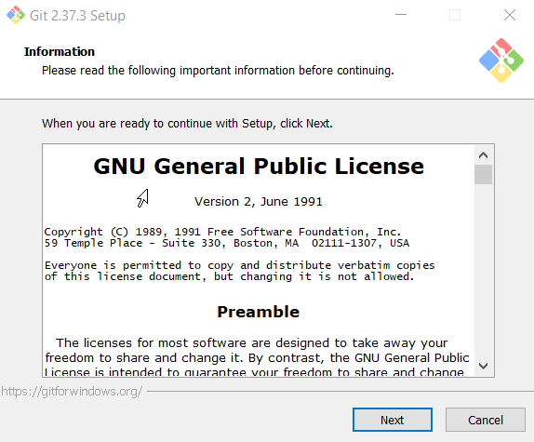
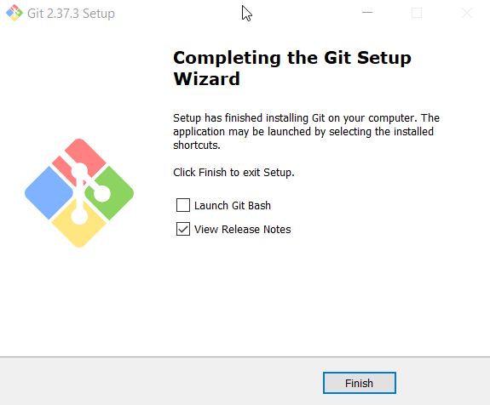
Installation of git for Windows

Slide 5
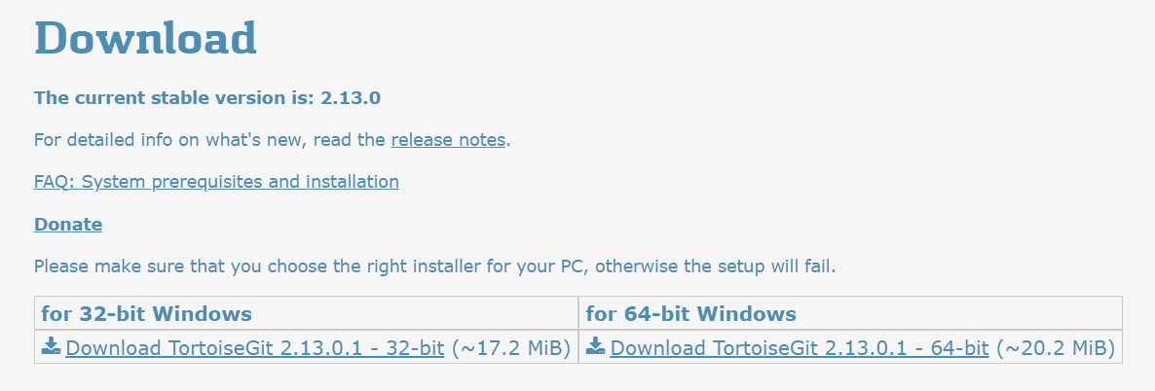
Installation of TortoiseGit
tortoisegit.org ->> Download

Slide 6
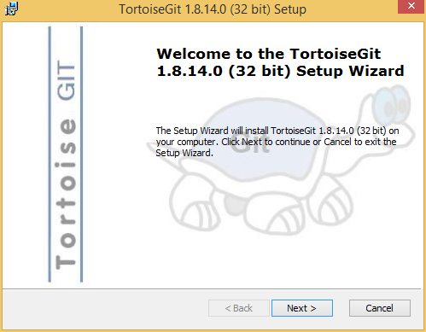
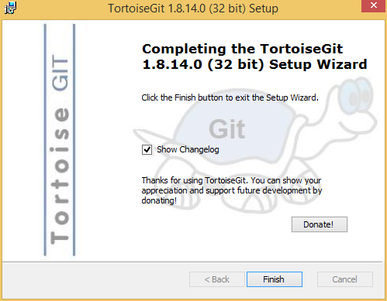
Installation of TortoiseGit

Slide 7
Configuration the Git URL and Password

Slide 8
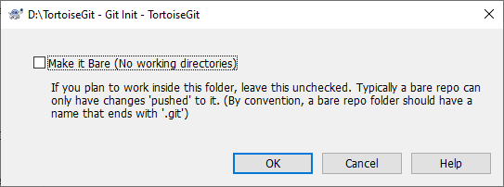
Repository Processes: Create Repository
At an empty directory, just use the explorer context menu and select Git Create Repository here.
You can choose here between a bare and normal git repository. A normal repository has a working tree attached to which files can be checkout out and committed whereas a bare repository only can be pushed to and pulled from.

Slide 9
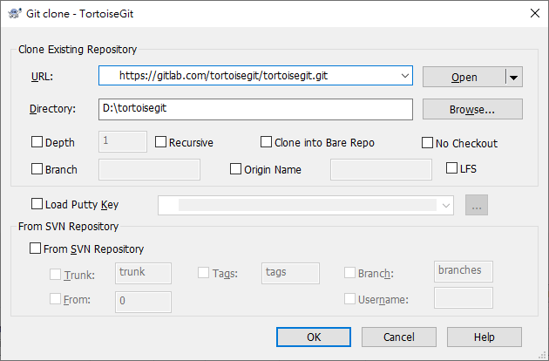
Repository Processes: Clone Repository
This section talks about how to clone a git repository from an existing repository. This operation is used to get a full copy of a remote repository. Cloning a git repository is very simple. At an empty directory, just use the explorer context menu and select Git Clone.

Slide 10
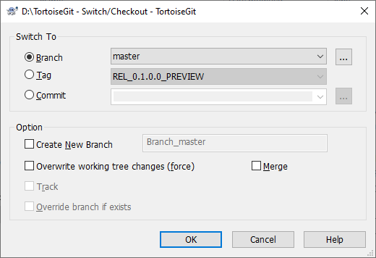
Repository Processes: Checking Out a Working Tree
Select a git repository directory in windows explorer Right click to pop up the context menu and select the command TortoiseGit → Switch/Checkout.

Slide 11
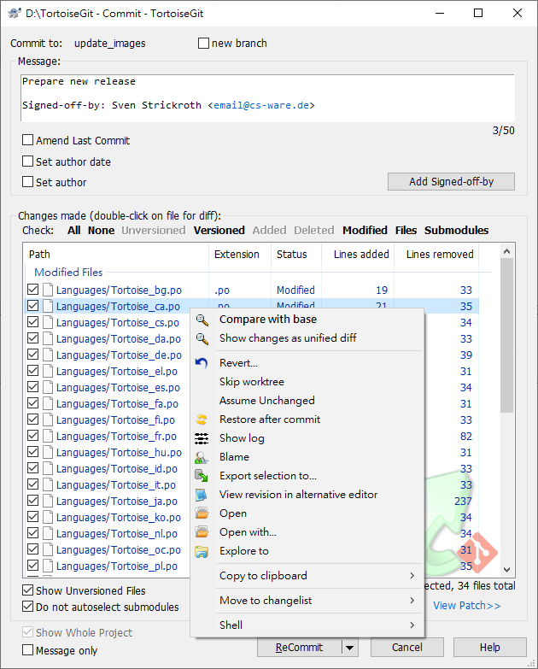
Repository Processes: Commiting Changes to the Repository
Storing the changes you made to your working tree is known as committing the changes. you can use TortoiseGit → Check for Modifications first, to see which files have changed locally.
If there are no conflicts, you are ready to commit your changes. Select any file and/or folders you want to commit, then TortoiseGit → Commit.

Slide 12
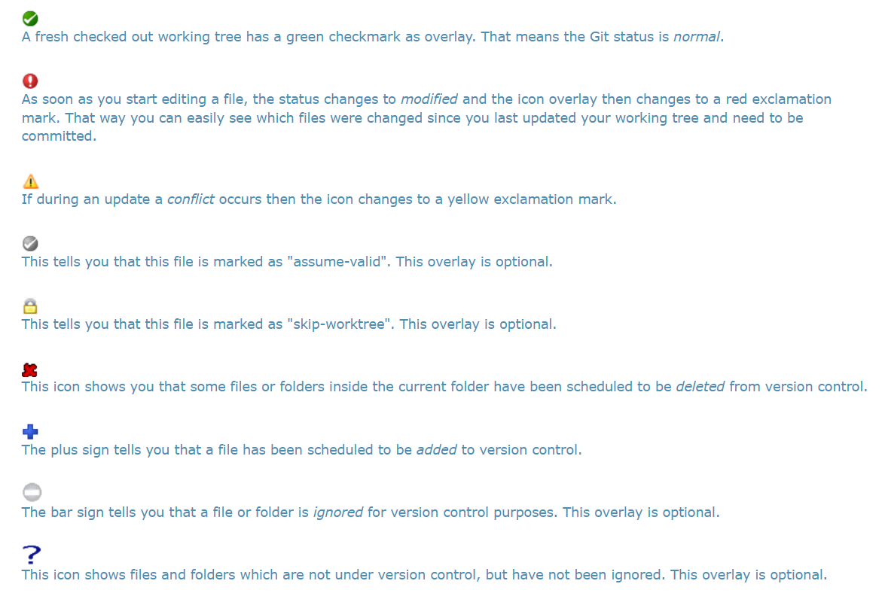
Getting Status Information: Files & Directories

Slide 13
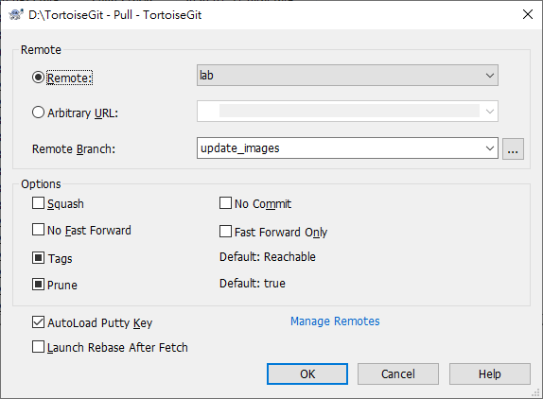
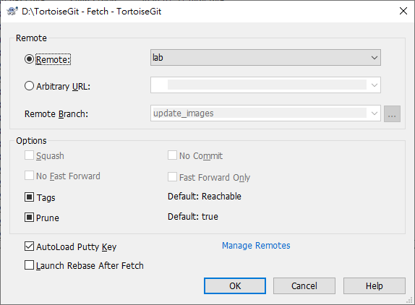
Pull & Fetch, Push: Pull & Fetch
A pull/fetch can be initiated by using TortoiseGit → Pull or TortoiseGit → Fetch.
Fetch just downloads the objects and refs from a remote repository and normally updates the remote tracking branches. Pull, however, will not only download the changes, but also merges them - it is the combination of fetch and merge (cf. the section called “Merging”). The configured remote tracking branch is selected automatically.

Slide 14
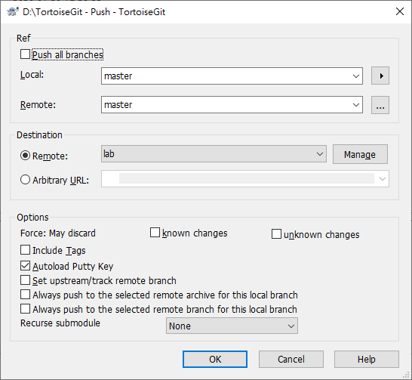
Pull & Fetch, Push: Push
In order to perform a push open the push dialog using TortoiseGit → Push.

Slide 15
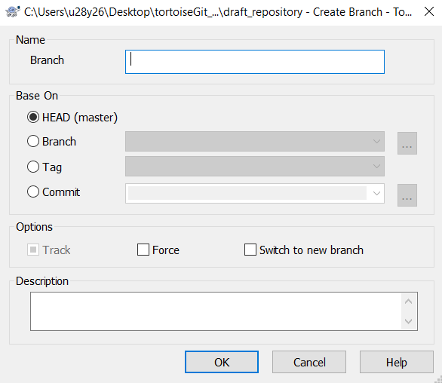
Pull & Fetch, Push:Branch
In order to perform a creating branch, open the branch dialog using TortoiseGit → Create Branch.

Slide 16
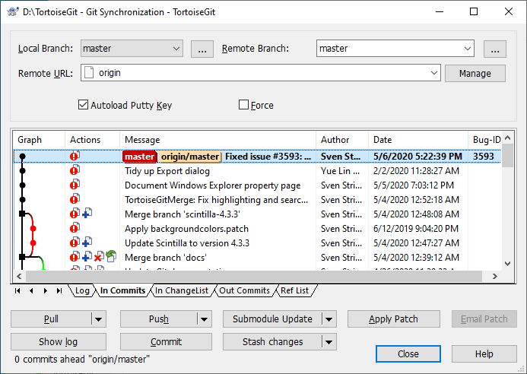
Synchronization
Select a git repository directory in windows explorer Right click to pop up the context menu and select the command Git Sync.
The Sync Dialog provides an interface for all operations related with remote repositories in one dialog. This includes push, pull, fetch, remote update, submodule update, send patch... However, the sync dialog provides less options as the regarding dialogs (cf. the section called “Pull and Fetch change” and the section called “Push”).

Slide 17
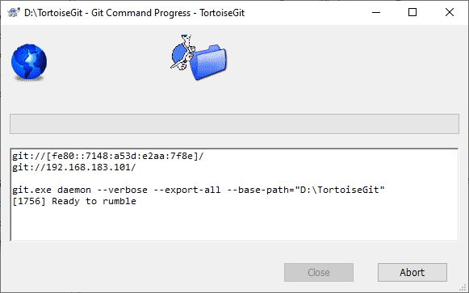
Daemon
Sometimes you want to quickly share you local repository to others without pushing to a remote git repository. That's when you need to use TortoiseGit → Daemon.

Slide 18
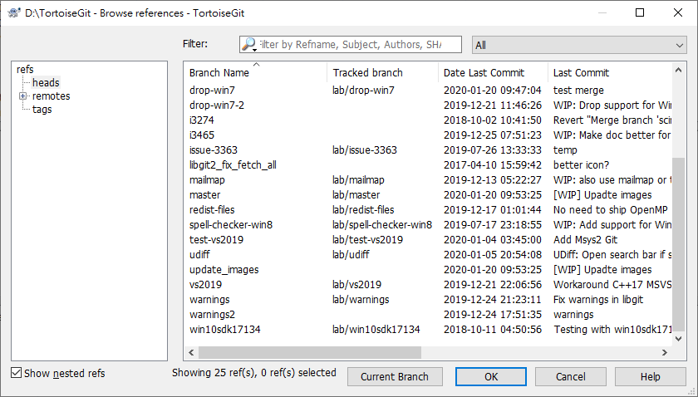
Browse the References
This section talks about the reference browser, which allows you to view and work with all refs (tags, branches, remote branches, stash and so on). It can be opened using TortoiseGit → Browse Reference.

Slide 19
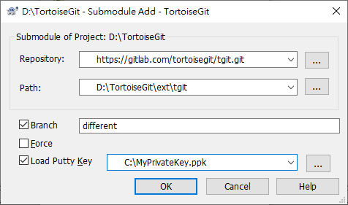
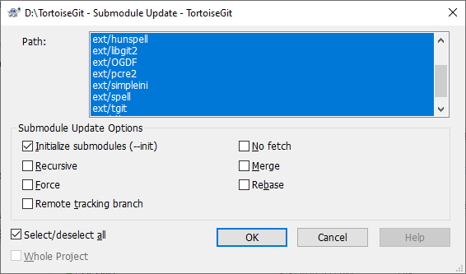
Submodules
When you want to embed foreign repositories into a working tree/git repository, this is called a submodule. Here using the TortoiseGit → Submodules Add/Update/Sync option a foreign repository can be embedded into a dedicated sub directory of the source tree. When selecting this option, a dialog pops up:

Slide 20
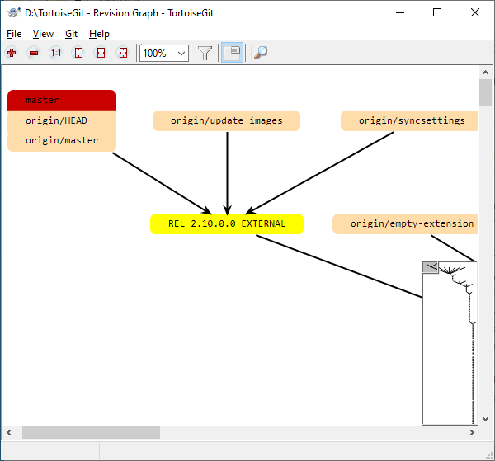
Revision Graphs
Sometimes you need to know where branches and tags were taken from the point, and the ideal way to view this sort of information is as a graph or tree structure. That's when you need to use TortoiseGit → Revision Graph...

Slide 21
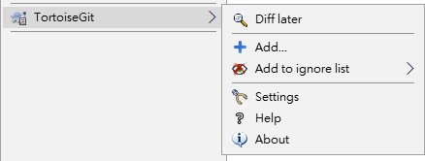
Adding, Moving and Deleting File/Folder: Add
If you created new files during your development process then you need to add them to source control too. Select the file(s) and/or NOT empty directory and use TortoiseGit → Add.
After you added the files to source control the file appears with aadded icon overlay which means you first have to commit (and push) your working tree to make those files available to other developers. Just adding a file does not affect any remote repository!

Slide 22
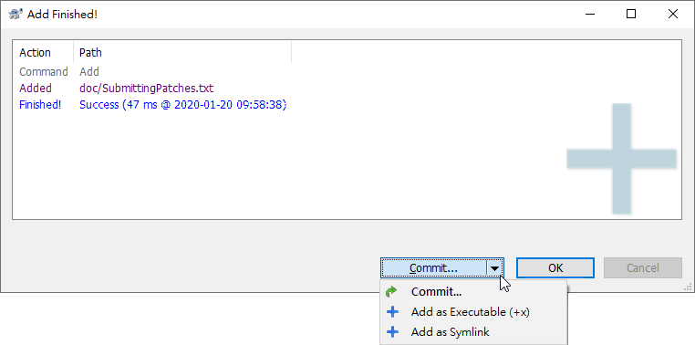
Adding, Moving and Deleting File/Folder: Add Existing External File
To add files from outside your working tree you can use the drag-and-drop handler:
select the files you want to add
right-drag them to the new location inside the working tree
release the right mouse button
select Context Menu → Git Add copy and add files. The files will then be copied to the working tree and added to version control.
You can also add files within a working tree simply by (left-)dragging and dropping them onto the commit dialog.
If you add a file by mistake, you can undo the addition before you commit using TortoiseGit → Delete (keep local) or Revert

Slide 23
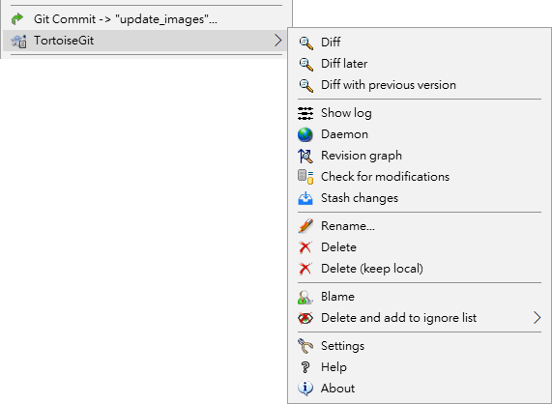
Adding, Moving and Deleting File/Folder: Delete
Use TortoiseGit → Delete to remove files or folders from Git.
If you want to delete an item from the repository, but keep it locally as an unversioned file/folder, use Extended Context Menu → Delete (keep local).
If you have deleted a file or a folder and already committed that delete operation to the repository, then, right-click and select Context Menu → Revert to this revision.

Slide 24

Adding, Moving and Deleting File/Folder: Move
If you want to move files around inside your working tree, perhaps to a different sub-folder, you can use the right-mouse drag-and-drop handler:
select the files or directories you want to move
right-drag them to the new location inside the working tree
release the right mouse button
in the popup menu select Context Menu → Git Move versioned files here

Slide 25
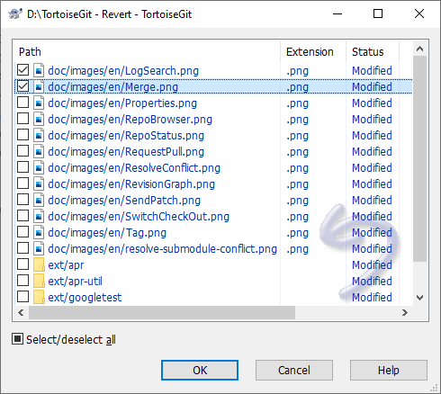
Undo Changes
If you want to undo all changes you made in a file since your last commit you need to select the file, right click to pop up the context menu and then select the command TortoiseGit → Revert A dialog will pop up showing you the files that you've changed and can revert. Select those you want to revert and click on OK.

Slide 26
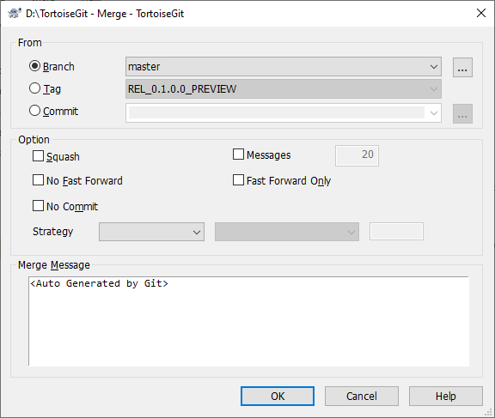
Merging
Merging always takes place within a working tree. If you want to merge changes into a branch, you have to have a working tree for that branch checked out, and invoke the merge wizard from that working tree using TortoiseGit → Merge.
Where branches are used to maintain separate lines of development, at some stage you will want to merge the changes made on one branch back into the other branch, or vice versa.

Slide 27
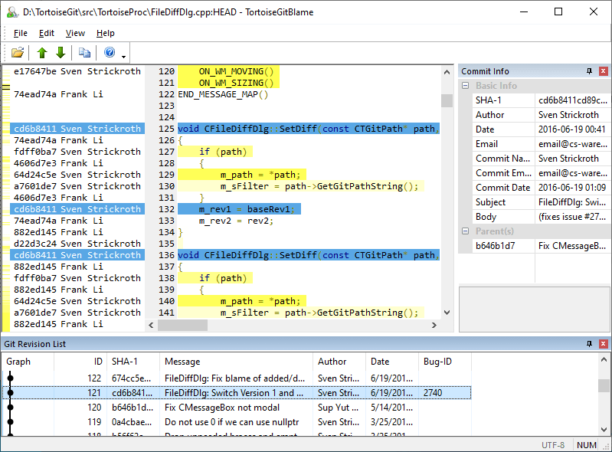
Who Changed Which Line: Blame for Files
Sometimes you need to know not only what lines have changed, but also who exactly changed specific lines in a file. That's when the TortoiseGit → Blame. command, sometimes also referred to as annotate command comes in handy.
This command lists, for every line in a file, the author and the revision the line was changed.
By default the blame file is viewed using TortoiseGitBlame, which highlights the different revisions to make it easier to read.

Slide 28
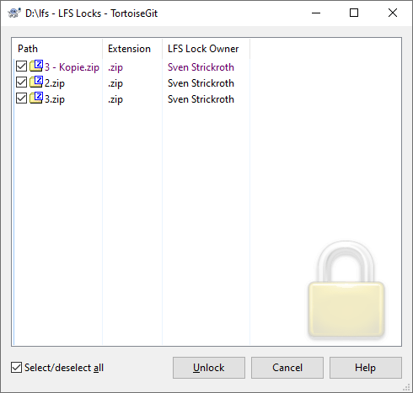
Git LFS (Large File Support) Locking
File locking allows developers to lock files they are updating to prevent other users from updating them at the same time.
In order to edit a lockable file you need to lock it using context menu via TortoiseGit → LFS → Lock.
When you're done editing a file it's good practice to push and unlock it as soon as possible. To unlock the file use the context menu and choose TortoiseGit → LFS → Unlock.
In order to open Locks Dialog use TortoiseGit → LFS → Locks in any folder inside the working tree.

